Slide 1

Shelter Dog Adoption Database Management System
Optimizing Adoption Efficiency & Shelter Management
ISM 6212
Selena

Slide 2

Project Objectives
Automate adoption matching to improve efficiency
Monitor shelter capacity and prevent overcrowding
Generate automated reports for tracking adoptions and operations
Simplify data entry and search functionality for shelter workers
Visual representation of tables and relationships
Ensures data integrity and efficient structure

Slide 3
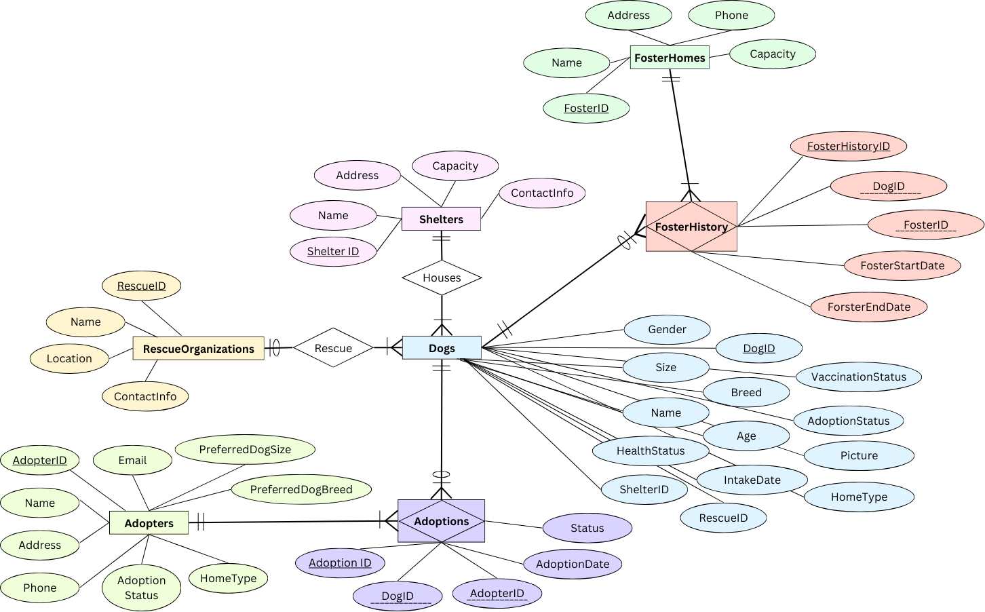
ER Diagram

Slide 4
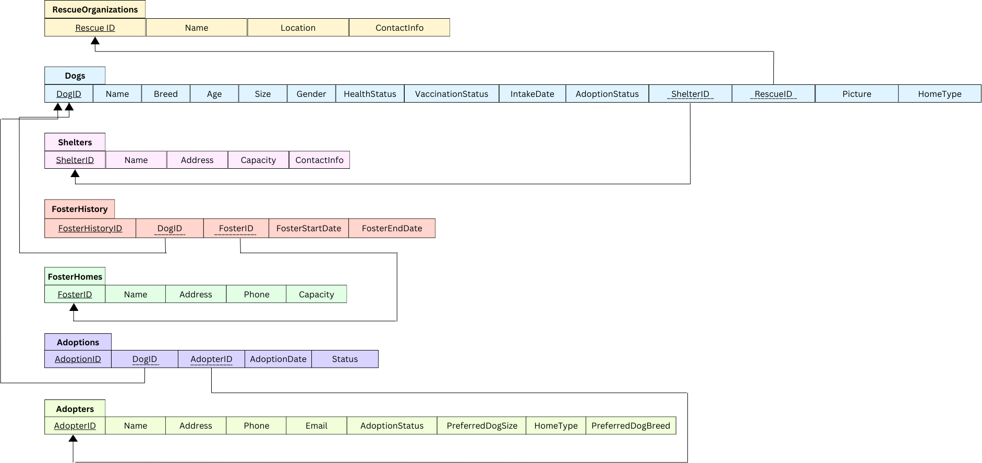
Relational Schema

Slide 5

Key Forms and Features
Dog Registration Form: Stores detailed dog info
Adopter Profile Form: Captures adopter preferences
Search & Match Form: Finds best adoption matches dynamically
Shelter Management Form: Tracks available dogs and occupancy levels
Overcapacity Alert: Triggers when shelter capacity exceeds 70%

Slide 6
Technical Demonstration – Query Automation
DogMatch_Q Query: Matches adopters with available dogs based on size, breed, and home type
OccupancyRisk Query: Identifies shelters over 70% capacity
Adoption Report Query: Tracks completed adoptions and updates dog statuses
Queries automate search, reporting, and decision-making processes

Slide 7

Macros & Automation
Overcapacity Alert Macro: Warns when shelter exceeds capacity
Search & Match Form Automation: Instantly retrieves best matches for adopters
Report Automation: Generates adoption confirmation and shelter occupancy reports
Reduces manual workload and improves efficiency

Slide 8




Reports and Documentation
Adoption Confirmation Report: Details completed adoptions
Shelter Occupancy Report: Lists shelters, their capacity, and occupancy levels
Dog Matching Report: Provides ranked matches for adopters
Ensures transparency, tracking, and efficient decision-making

Slide 9

Post-Mortem Analysis – Lessons Learned
• What Went Well:
- Automated matching system optimized efficiency - Overcapacity alerts improved shelter monitoring
- Forms, reports, and automation enhanced usability
• Challenges Faced:
- SQL JOIN errors led to duplicate matches
- Adoption status updates required fine-tuning
- Query performance needed optimization
• Future Improvements:
- Expand the dataset with more behavioral and lifestyle columns
- Build additional reports and labels
- Improve query efficiency and automation

Slide 10
Key Takeaways
Database optimizes adoption matching and shelter management
Automated alerts and reports improve decision-making
Structured data ensures accuracy and referential integrity
Future expansions: More data, optimized performance, and AI-based recommendations

Slide 11
Thank you for your time

